Slide 1
Increasing impact of machine learning
through visualization
Ali Madani
Farnoosh Khodakarami

Slide 2
Why do we care about visualization
Exploring data
Discover important characteristics

Slide 3
Why do we care about visualization
Exploring data
Discover important characteristics
Proper communication
Make sure everybody understand our massage

Slide 4
Why do we care about visualization
Exploring data
Discover important characteristics
Proper communication
Make sure everybody understand our massage
Educating people
Teaching
Helping others to learn about our models and results

Slide 5
Let’s be smart in visualization
Do not make it confusing

Slide 6
Let’s be smart in visualization
Do not make it confusing
We could use 100 data points with messy distribution
You agree that these 9 data points are better

Slide 7
Let’s be smart in visualization
Do not make it confusing
Help the readers (of reports) or audience focus on the important parts (attention)

Slide 8
Let’s be smart in visualization
Do not make it confusing
Help the readers (of reports) or audience focus on the important parts (attention)
I could just write or say data points a and e
You agree that using another color (red) was better
a
b
e
d
c

Slide 9
Exaggerate if it is not real data
Which one is better?
Outlier

Slide 10
Exaggerate if it is not real data
Which one is better?
Outlier
Outlier

Slide 11
Exaggerate if it is not real data
Which one is better?
Outlier
Outlier
Outlier

Slide 12
Attention and shapes
Exact values
Text
Relative position
Length
1.2
2.3
10.5

Slide 13
Attention and shapes
Ratio
Text
Relative position
Length
1.2
2.3
10.5

Slide 14
Attention and shapes
Drawing attention
Text
Relative position
Length
Area
Color
1.2
2.3
10.5

Slide 15
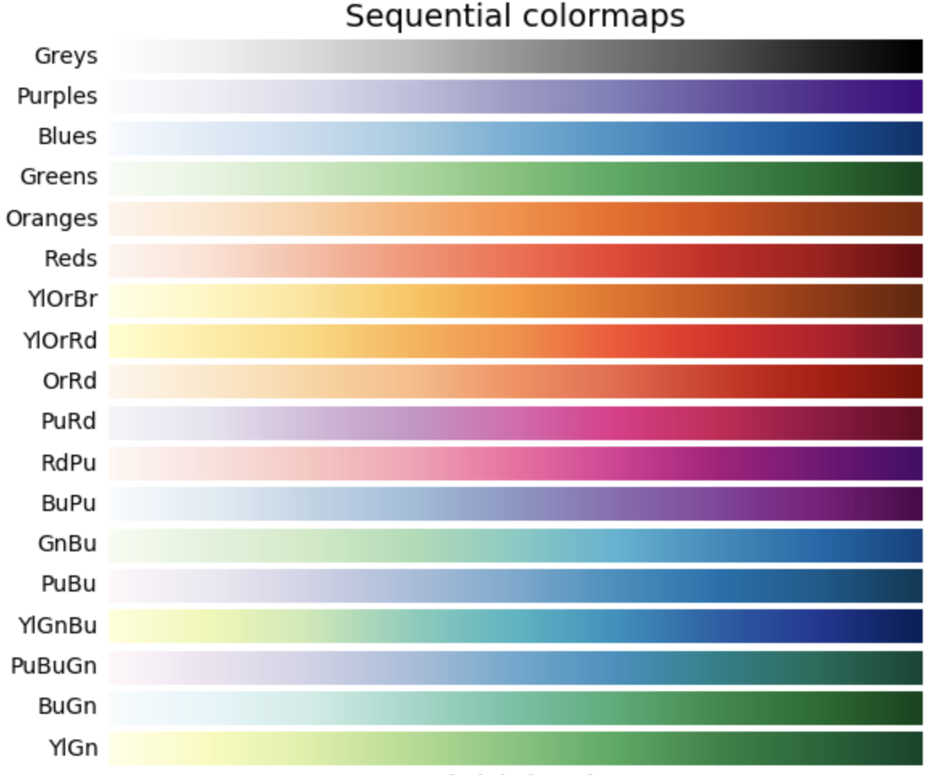
Sequential color maps to show the gradient
https://matplotlib.org/3.1.1/tutorials/colors/colormaps.html

Slide 16
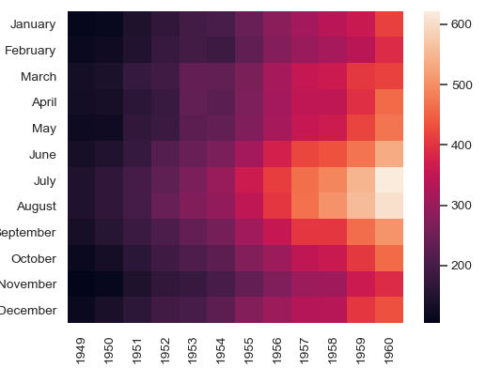
Sequential color maps to show the gradient
https://seaborn.pydata.org/generated/seaborn.heatmap.html

Slide 17
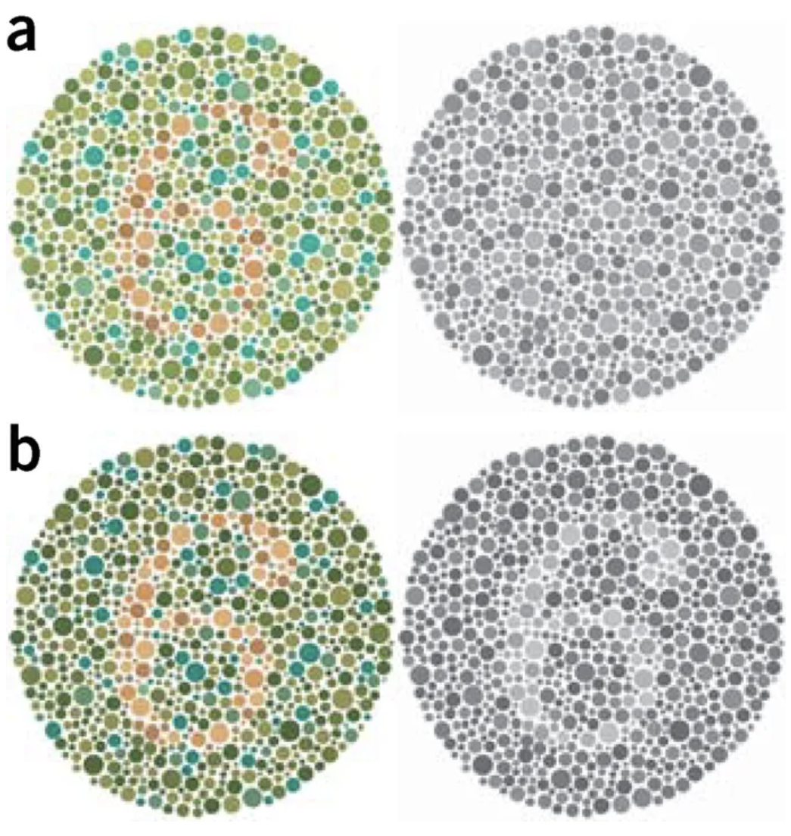
Playing with brightness
Wong, Bang. "Points of view: Color blindness." (2011): 441.

Slide 18
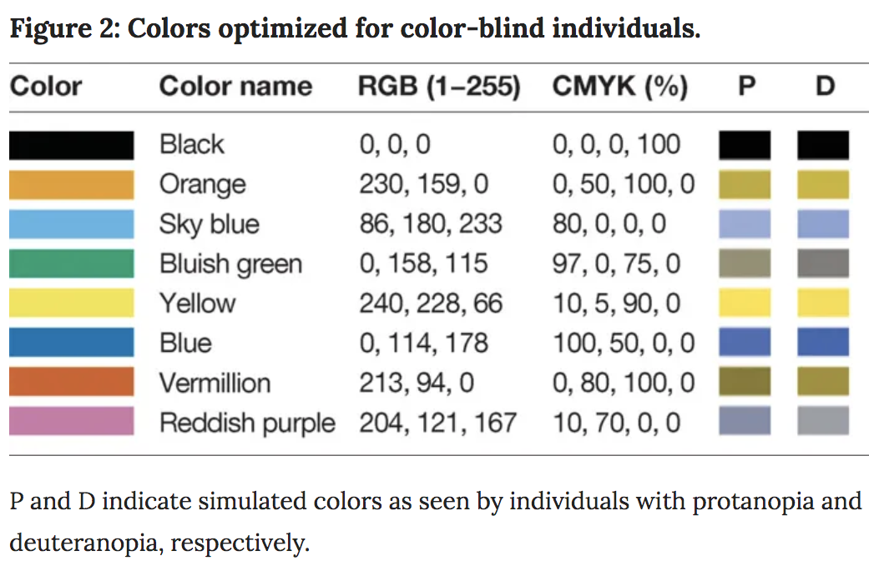
Point of view: color blindness
Wong, Bang. "Points of view: Color blindness." (2011): 441.

Slide 19
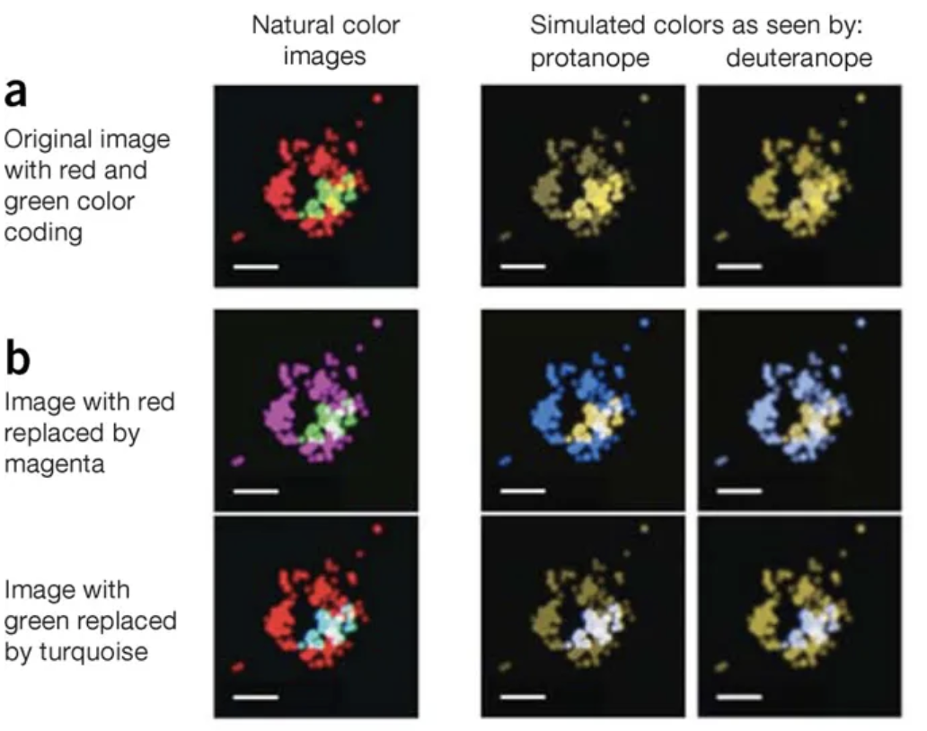
Point of view: color blindness
Wong, Bang. "Points of view: Color blindness." (2011): 441.

Slide 20
Interview questions in machine learning
Ali Madani
Farnoosh Khodakarami

Slide 21
What Are the Different Types of Machine Learning?
Supervised learning
Unsupervised learning
Reinforcement learning

Slide 22
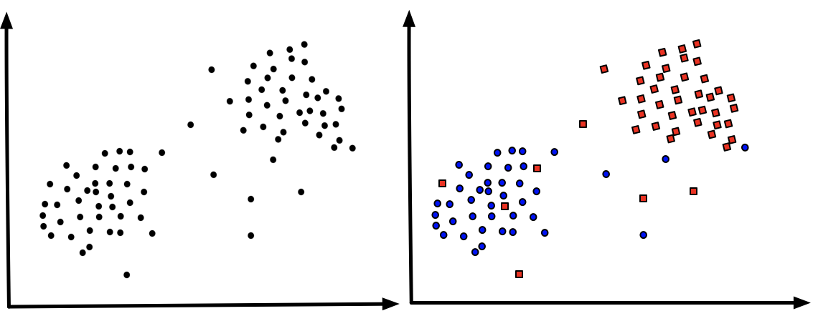
Unsupervised learning
Supervised learning

Slide 23
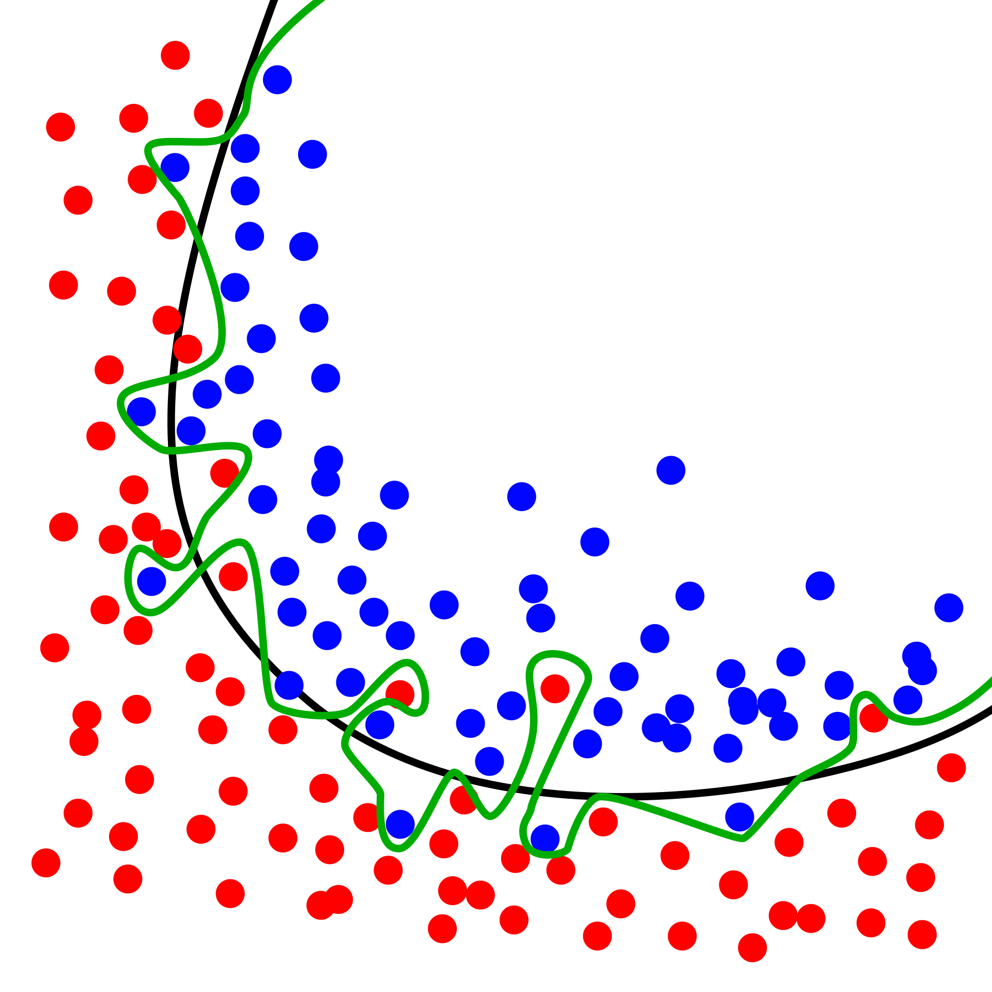
What Is Overfitting, and How Can You Avoid It?
Overfitting: Good performance on the training data, poor generalization to other data.
Underfitting: Poor performance on the training data and poor generalization to other data

Slide 24
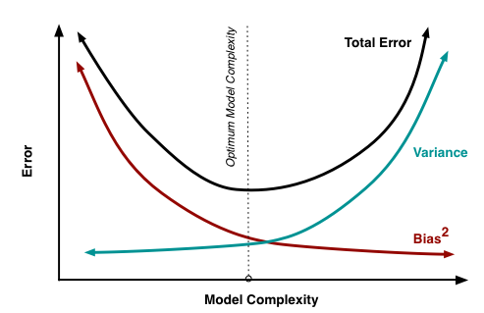
Bias–Variance Tradeoff

Slide 25
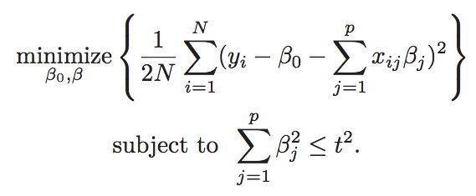
Regularization to overcome overfitting
Ridge regression
Objective function:
Constraint for regularization:
Hastie, T., Tibshirani, R., & Wainwright, M. (2015). Statistical learning with sparsity: the lasso and generalizations. Chapman and Hall/CRC

Slide 26
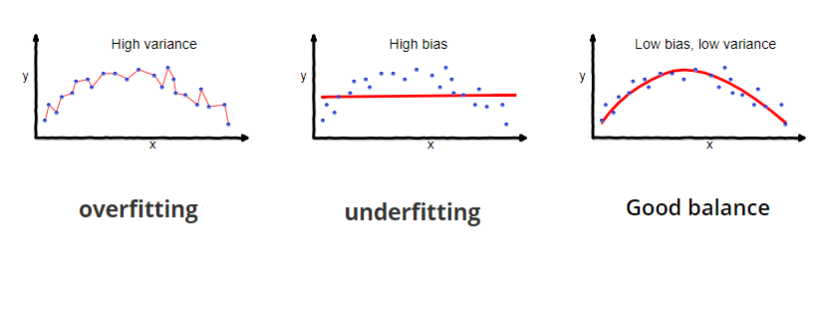
What is Bias and Variance in a machine learning model?

Slide 27

What are training, validation and test sets?
Data | Use | Size
Training | Model training (parameter optimization) | Big
Validation | Assessing variance and hyperparameter optimization | Big or small Smaller than training
Test | Assessing variance | Smaller than validation
New data | I am the goal | Very small

Slide 28
How Can You Choose a Classifier Based on your Training Set?
Small training set
model that has a right bias and low variance
Checking bias of different models in training set
Choosing low complexity models to make sure about generalizability

Slide 29

Explain the Confusion Matrix
We like to have a diagonal confusion matrix
High TP and TN
Low FP and FN

Slide 30
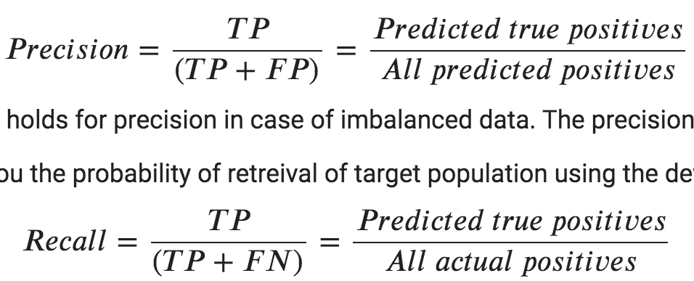
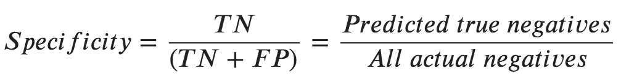
Explain precision, recall, FPR and FNR and their importance in different problems

Slide 31
Explain precision, recall, FPR and FNR and their importance in different problems
Specificity = true negative rate (TNR)
Sensitivity = recall = true positive rate (TPR)
FPR = 1-TNR
FNR = 1-TPR

Slide 32
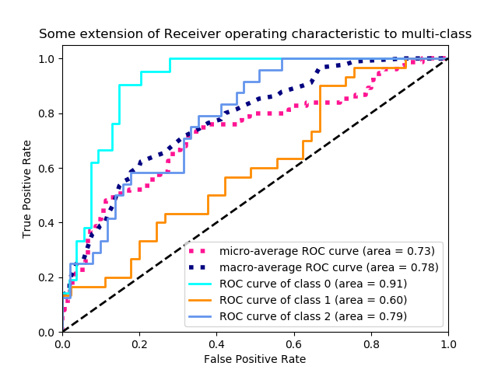
ROC Curve
Compute Receiver operating characteristic

Slide 33
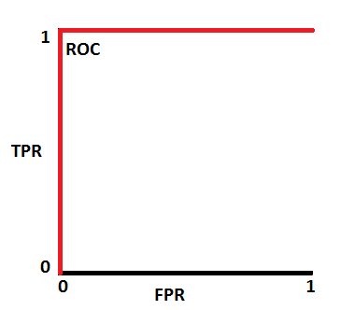
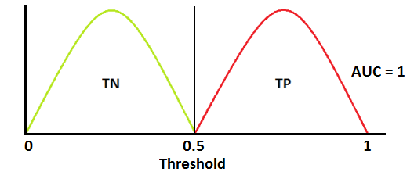
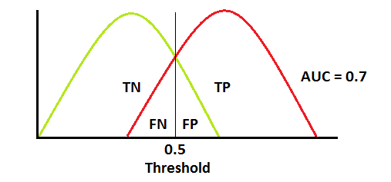
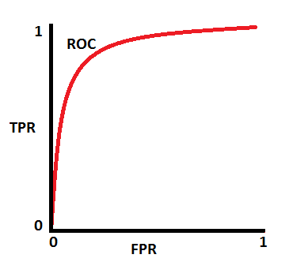
https://towardsdatascience.com/understanding-auc-roc-curve-68b2303cc9c5

Slide 34
Give some examples of supervised learning in industries
Image recognition
Face recognition
Medical diagnosis
Predicting stock price
Predicting house market change

Slide 35
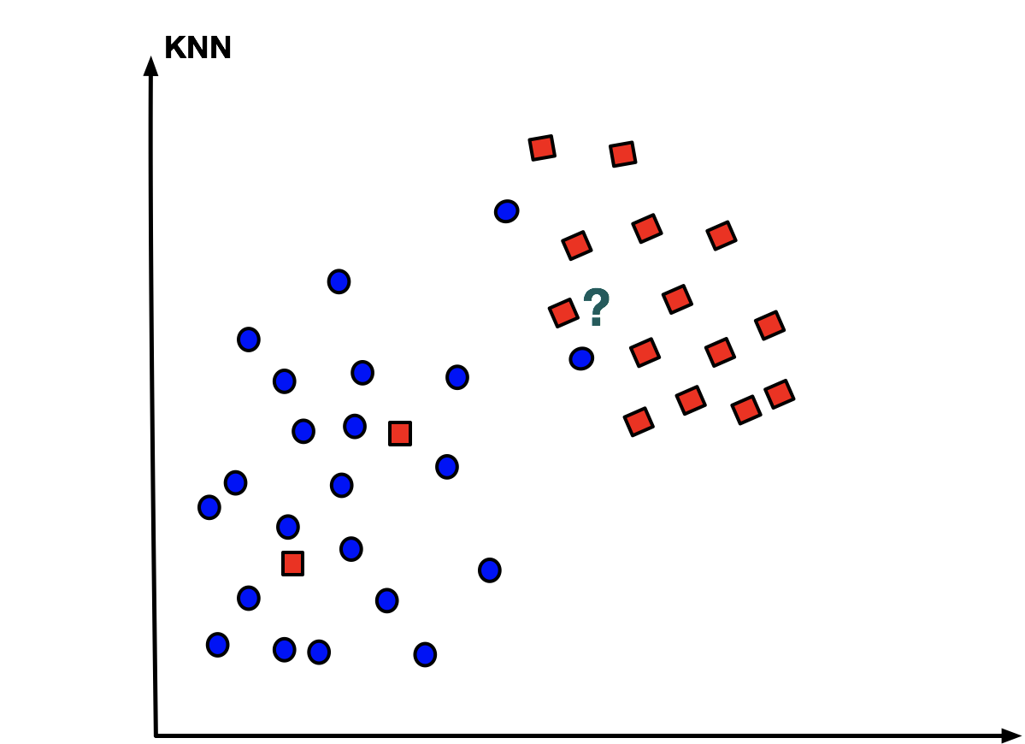
What is the difference between k-means and k-NN?
Supervised learning (classification)
Unsupervised learning (clustering)
k-NN
hight
k-means
weight

Slide 36
How do you choose between the models to finally use it in the corresponding business?
Choosing low-bias models
Training set
Assess generalizability (overfitting)
Validation set
Assess the performance of the final chosen model
To have a clue about the potential performance in action

Slide 37
When do you use classification versus regression?
Regression (linear regression)
Classification (logistic regression)
y
Regression line
y
x
x
Continuous output
Categorical output

Slide 38
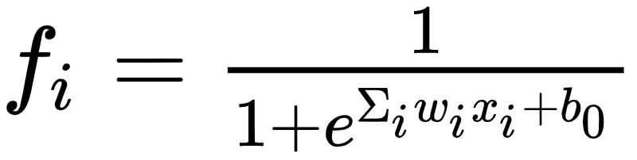
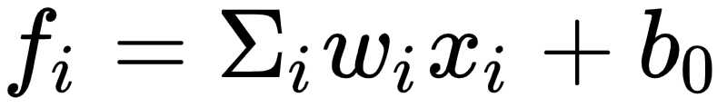
What is logistic regression?
Linear regression
Logistic regression

Slide 39
What is random forest?
Features of sample i
Decision tree 1
Decision tree 2
Decision tree 3
Decision tree M
Class 1
Class 1
Class 1
Class 1

Slide 40
Give some examples of dimensionality reduction methods
PCA: Principal Component Analysis
t-SNE: t-Distributed Stochastic Neighbor Embedding
UMAP: Uniform Manifold Approximation and Projection

Slide 41
Compare t-SNE to UMAP and discuss about interpretation of their results
Notes:
Similarities are computed from distances using a different kernel; it is not Gaussian, but it also decays exponentially and it also has adaptive width, as in t-SNE.
Similarities are not normalized to sum to 1, but still end up being normalized to sum a constant value.

Slide 42
t-SNE: t-Distributed Stochastic Neighbor Embedding
P-dimensional space
2D space
Mapping that preserves local structure of data
Neighbors remain neighbors
Dimension 2
No meaning in large distances
Dimension 1
The embedding does not preserve global structure of data

Slide 43
Compare t-SNE to UMAP and discuss about interpretation of their results
We can discuss about densities of groups in UMAP not in t-SNE
We can talk about large distances in UMAP not in t-SNE

Slide 44
Compare t-SNE to UMAP and discuss about interpretation of their results
We can discuss about densities of groups in UMAP not in t-SNE
We can talk about large distances in UMAP not in t-SNE

Slide 45


